Slide 1
Casual Rider vs. Member Rider Bicycle Use
By: Matthew Ferencz
Date: 06-28-2022

Slide 2
Presentation Topics:
Objective
Data Sources and Tools Used For Analysis
Observations
Final Observations & Recommendations:
Upcoming Plans
Questions

Slide 3
Objective:
Analyze data with regards to the use of bicycles from member and casual riders in order to come up with the best marketing strategy for Cyclstic Company to gain more member riders through the conversion of casual riders

Slide 4
Data Sources and Tools Used For Analysis:
Source:
Monthly data files collected from Cylcistic’s (Divvy Bikes) website
Time Range of Data Sources:
April 2021 to March 2022
Tools:
Microsoft Excel
Google’s BigQuery (SQL)
Tableau

Slide 5
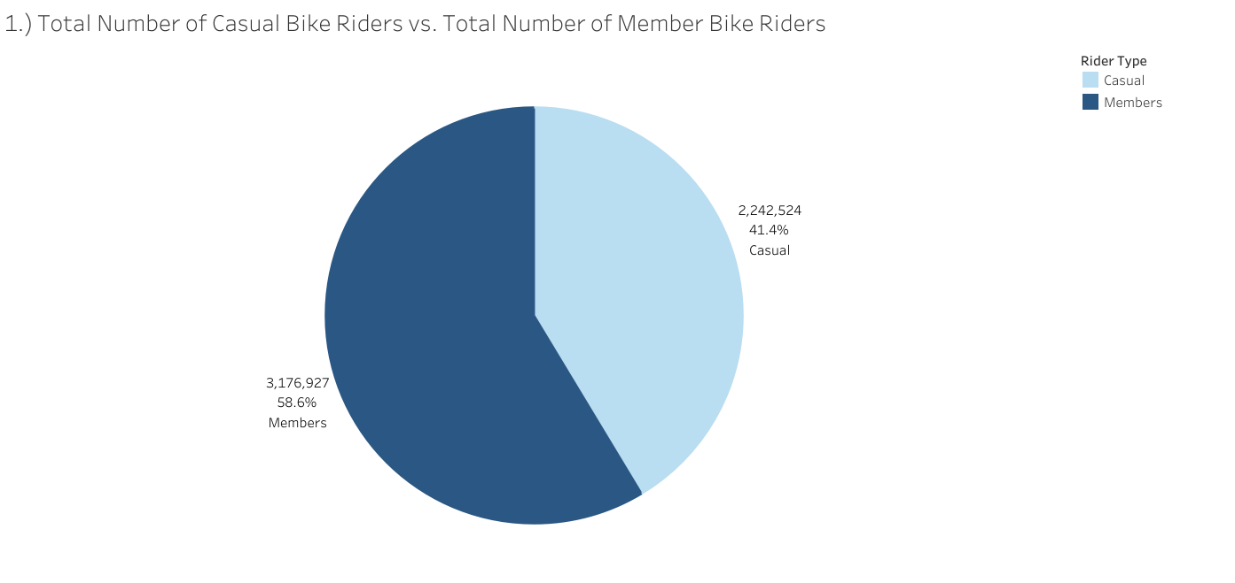
Number of Trips Overall

Slide 6
Observations:
Members are the most common rider type by percent of total
There were 5,419,541 total riders that took part in the 12-month time period this analysis covers

Slide 7
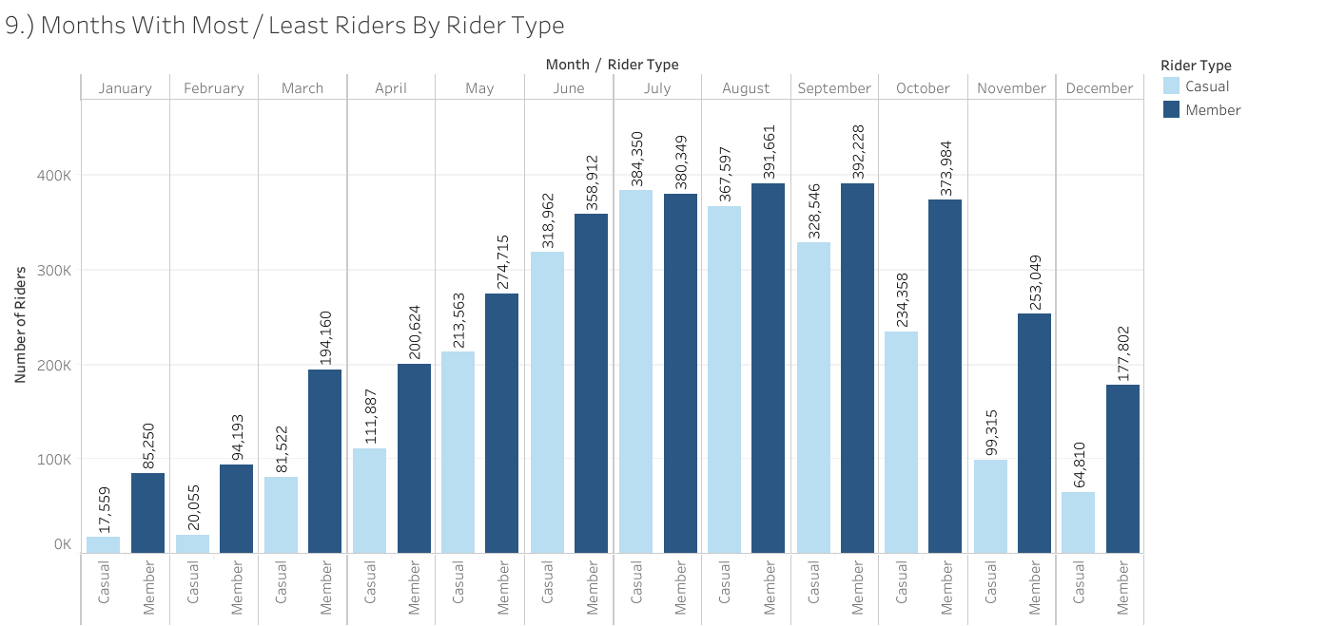
Monthly Trips By Rider Type

Slide 8
Observations:
Members had more ridership by month but the gap between member and casual riders decreased during traditionally warmer months (May thru August) with casual ridership overtaking member ridership in July

Slide 9
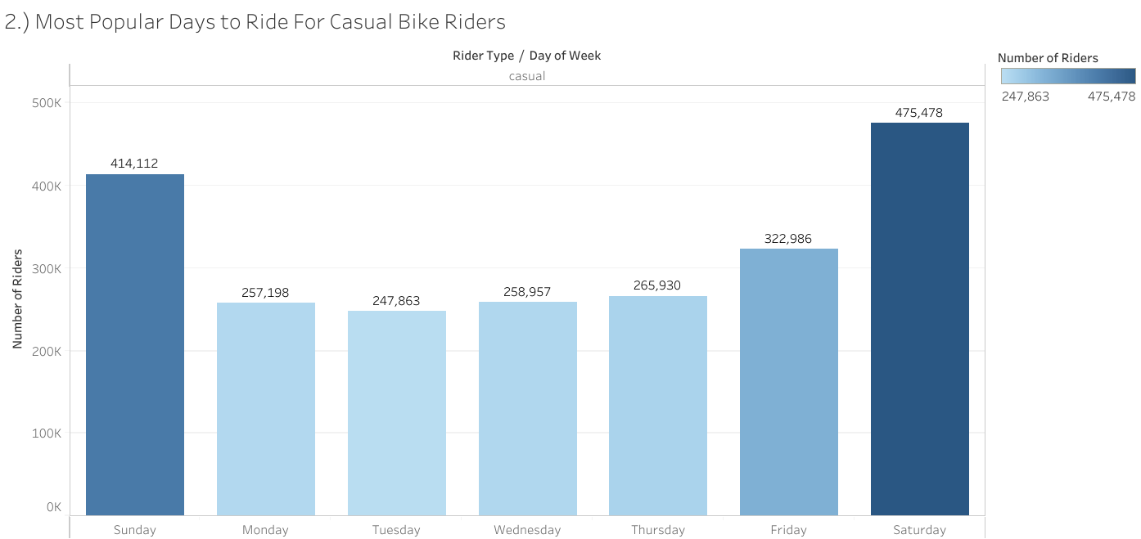
Daily Trips By Casual Rider Type

Slide 10
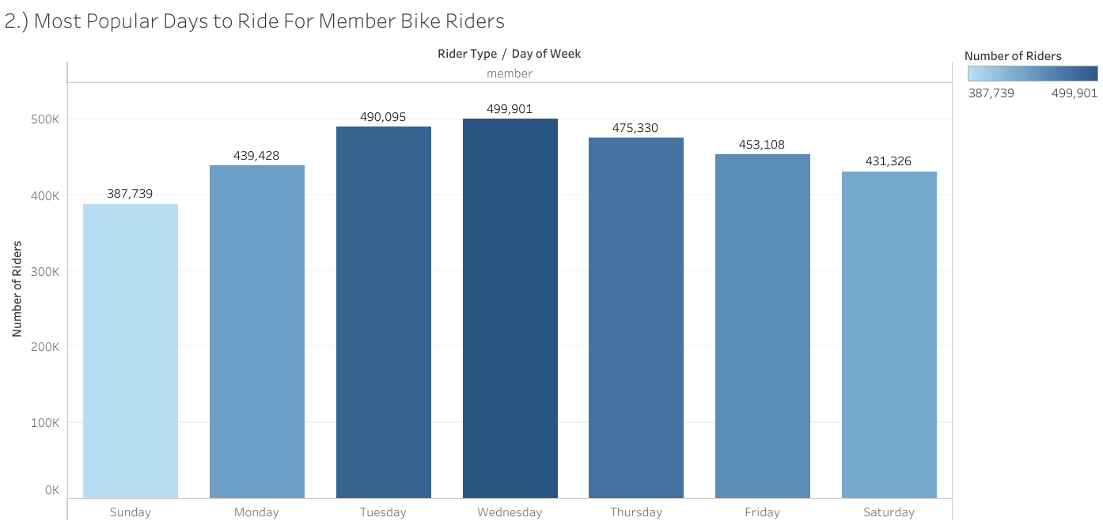
Daily Trips By Member Rider Type

Slide 11
Observations:
Casual riders were the more popular rider type over the weekends while members were the more popular rider type on weekdays

Slide 12
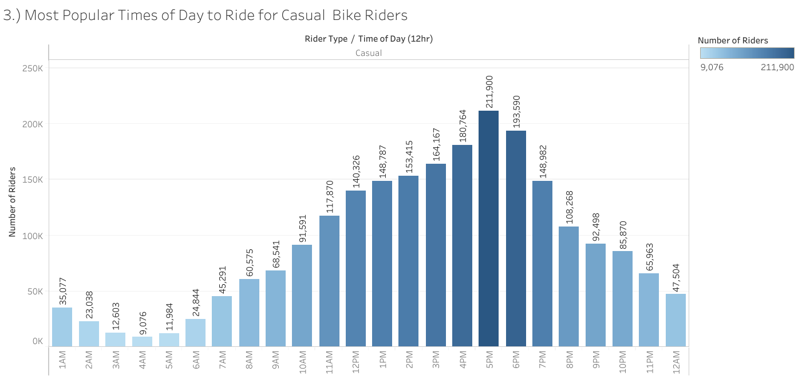
Number of Casual Rider Trips By Hour of Day

Slide 13
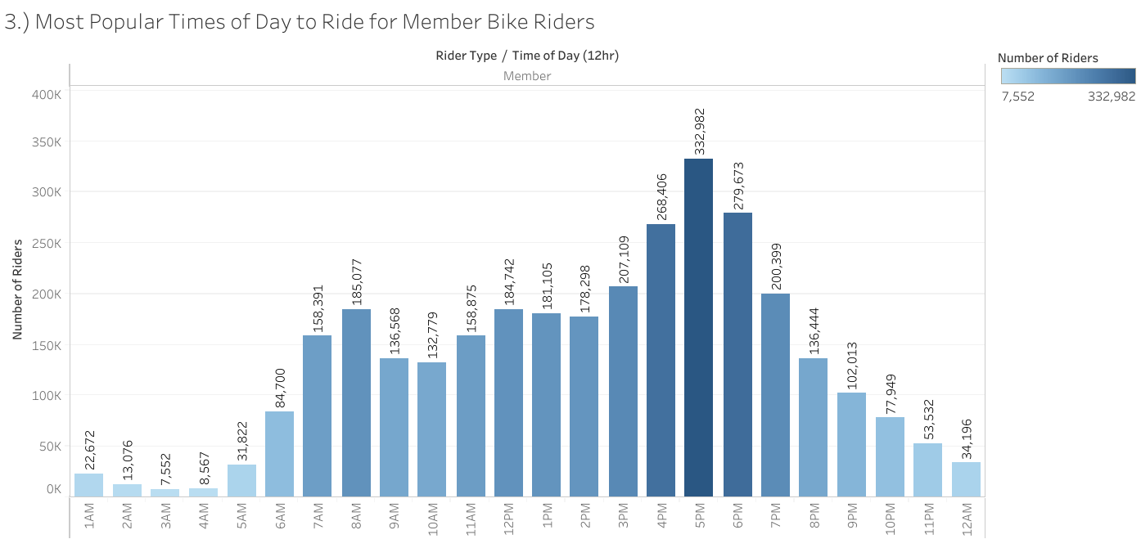
Number of Member Rider Trips By Hour of Day

Slide 14
Observations:
Most popular times for members most likely indicate trips from work commutes:
4PM to 7PM
7AM to 8AM
Trips made by casual riders increases throughout the day, peaking at 5PM

Slide 15
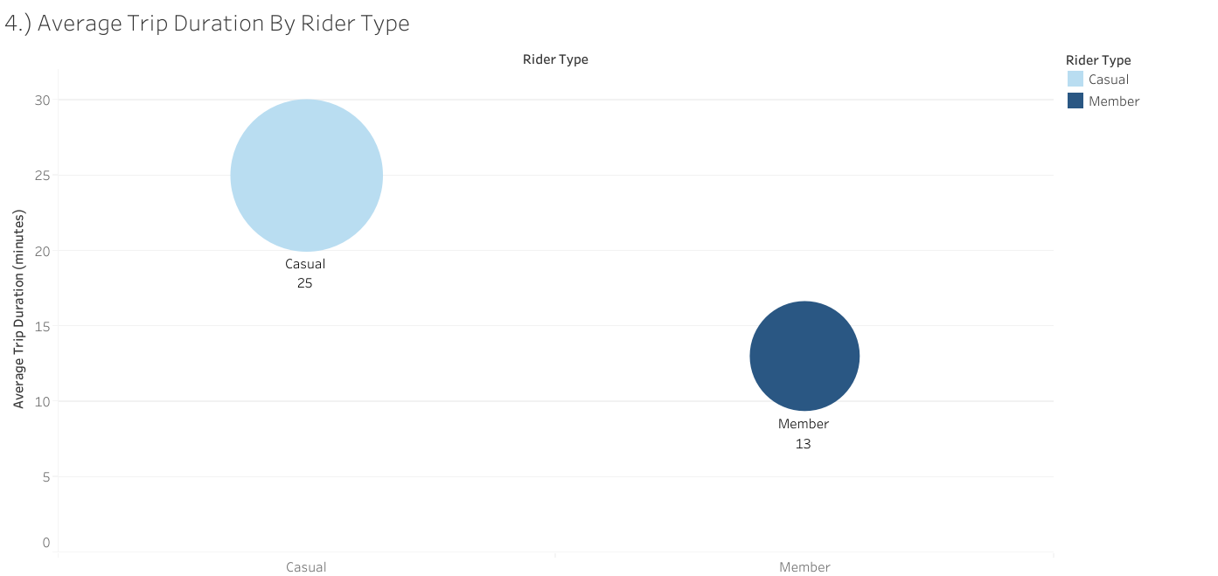
Average Trip Duration By Rider Type

Slide 16
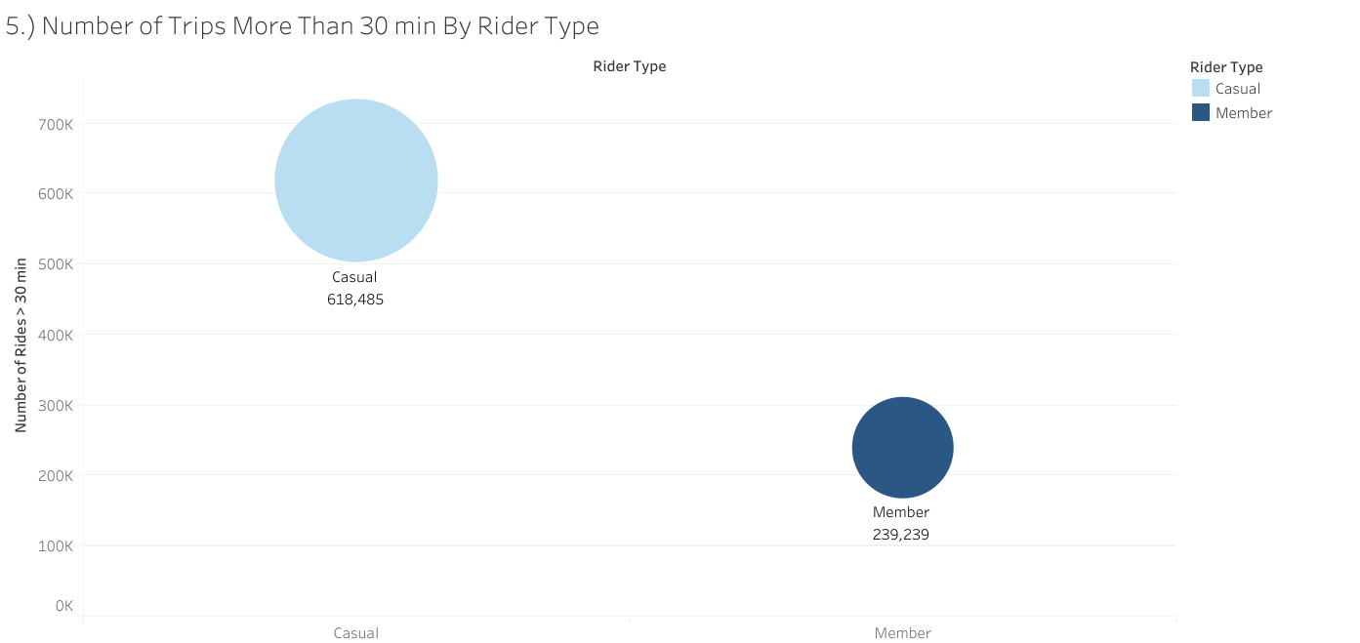
Which Rider Typer Had More 30-Minute Rides

Slide 17
Observations:
Casual riders have longer trips in terms of average duration in minutes than member riders, and almost three times the number of trips lasting longer than 30 minutes

Slide 18
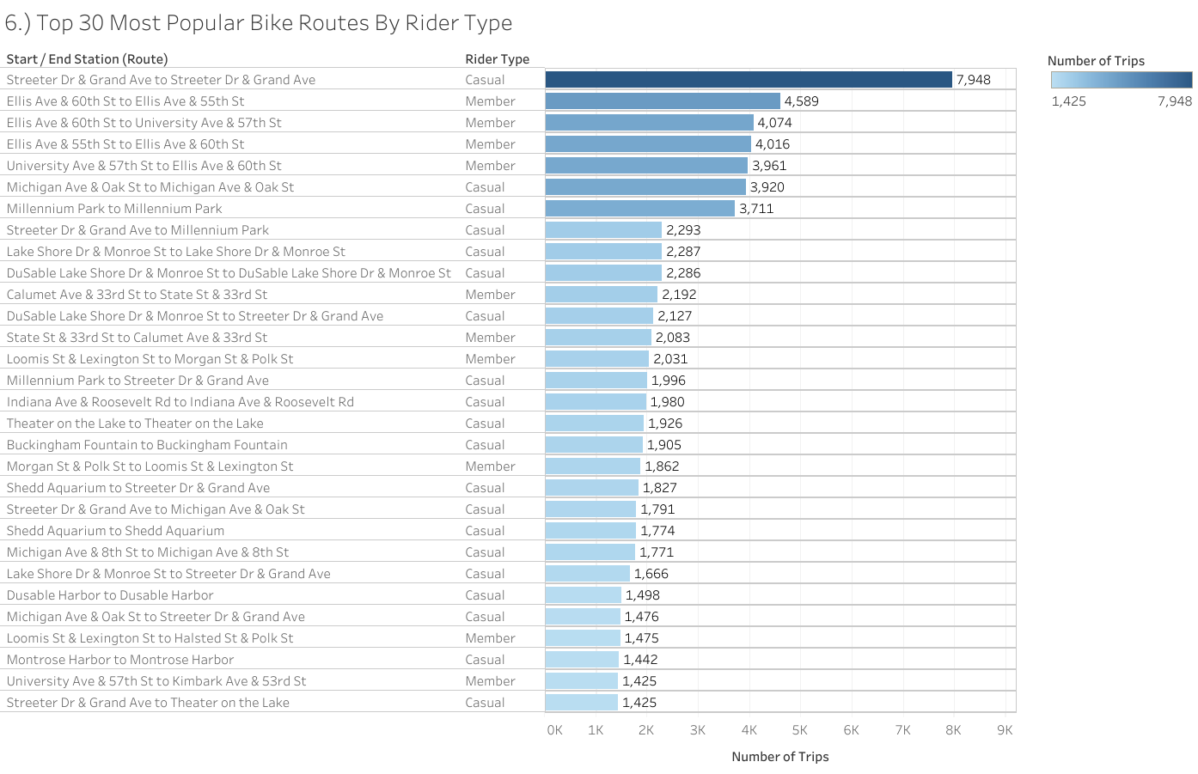
Top 30 Most Popular Routes For Member and Casual Riders

Slide 19
Observations:
There was no overlap in the most popular routes between member and casual riders
Most casual riders do the “Streeter Dr & Grand Ave” route
Member riders make more trips with similar start and end stations; Casual riders seem to be more random as a whole in their start and end station routes

Slide 20
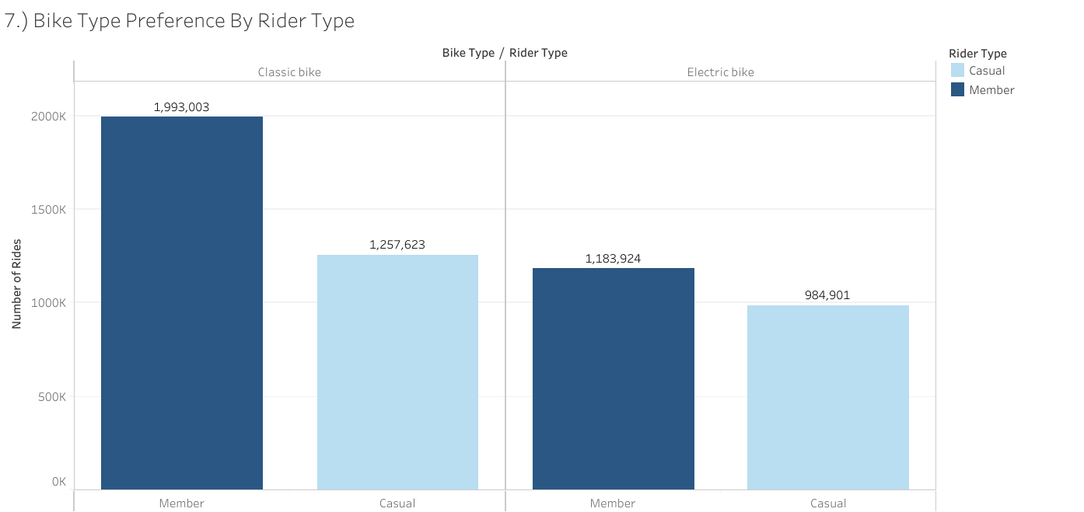
How Bike Type (Electric vs. Classic) Influences Member and Casual Ridership:

Slide 21
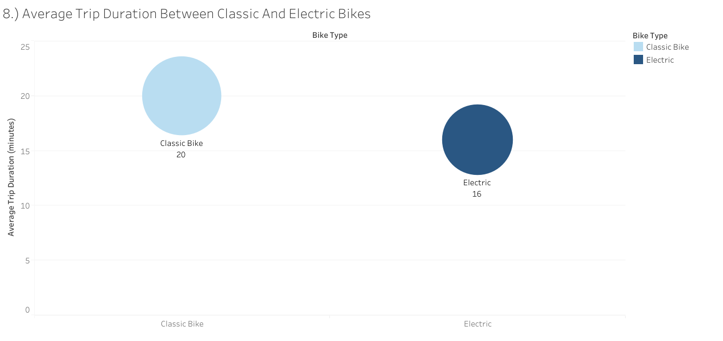
Average Trip Duration For Classic and Electric Bikes by Member and Casual Ridership

Slide 22
Observations:
Both member and casual riders prefer the classic bike while electric bikes were least preferred
Average trip duration had no significant influence on the preference to choose an electric bike over a classic bike as both types of bikes had similar averages.

Slide 23
Final Observations & Recommendations:
Members are the most common rider type
Many of the casual riders prefer to ride the “Streeter Dr & Grand Ave” station route
Cyclistic marketing campaigns and incentives can be focused on these areas to help convert casual riders to members
Members had more ridership by month but the gap between member and casual riders decreased during traditionally warmer months (May thru August) with casual ridership overtaking member ridership in July
Offer incentives to convert more casual riders to members during the warmer months
Casual riders on average took longer trips in terms of duration than member riders
The data suggests that casual riders use bikes mainly on weekends while Members tend to use them for getting to and from work during the weekdays
Attention should be aimed at those casual riders who use bikes like annual members during weekday commutes
Trips made by casual riders increases throughout the day, peaking at 5PM
Increase target ads and incentives to casual riders during this time of day as this popular time to ride overlaps with how member riders use their rides
Both annual members and casual riders prefer the classic over the electric bikes
Average trip duration had no significant influence on the preference to choose an electric bike over a classic bike
Do not focus investment on more electric bikes, rather, ensure classic bikes are readily available for use.

Slide 24
Upcoming Plans:
Deep dive into outlier data –
Try to understand why many station names are missing
I only used complete station name information for part of my analysis on popular routes (no nulls), potentially excluding some data
Determine what a “Docked Bike” represents, there was no explanation of them in the data’s notes, thus not knowing what they really represented I decided not to use them for my analysis
Figure out why there are duplicate rider IDs when they should all be unique values
Some trip lengths are 0 minutes in duration, why?
Boost data collection efforts –
Increase sample size of current study by reviewing multiple years’ worth of ridership data to determine if findings and observations in this analysis remain consistent over time
Match latitude and longitude information of popular routes to better visualize the popular rides on a map of surrounding areas
Match daily weather information to daily ride data to truly determine how seasons may impact ridership
Research other available public transportation means (city buses, rideshares, cabs, and rail transport) to determine how other choices play a role in city bike rider preferences
Politely request more data from users to further determine a typical rider ‘type’–
Gender and age at first for broad categorization → More detail later on (only if required)
Create a survey – ask riders relevant questions about their reasons for bike use, satisfaction, and factors influencing their decision to either become a member or stay as a casual rider

Slide 25
Questions?
Thank you

